Slide 1
Intro to electronics
Part 1 https://tinyurl.com/3xmw9jmh

Slide 2
Safety
Be aware of those around you
Don’t stick wires into electrical outlets
Don’t lick the batteries

Slide 3
What you’ll learn
Hands on
Basics of electricity
Basic electronic components (primitives)
How to use a breadboard (tinkering without kits)
Schematic reading
Where to learn more

Slide 4
Note on components
Components come in different shapes, sizes, and colors
If components in examples don’t look the same, ensure the pins line up in examples
If you need to move things left or right, OK!
Use a wire to connect example pin locations with your real world components

Slide 5
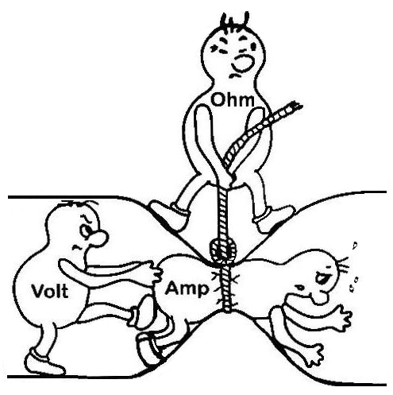
What is electricity?
Can be thought of like water
Volts is water pressure
Ohms is resistance/friction/drag from small pipes
Amps is volume of water moved
Can be used to do work
Electromagnetism
Magnetic fields (motors!)
EM Radiation (light, radio waves, etc)

Slide 6
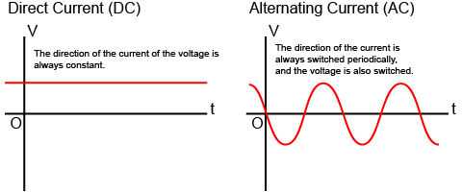
AC/DC
Electricity is provided in two forms
AC
DC
Batteries provide DC

Slide 7
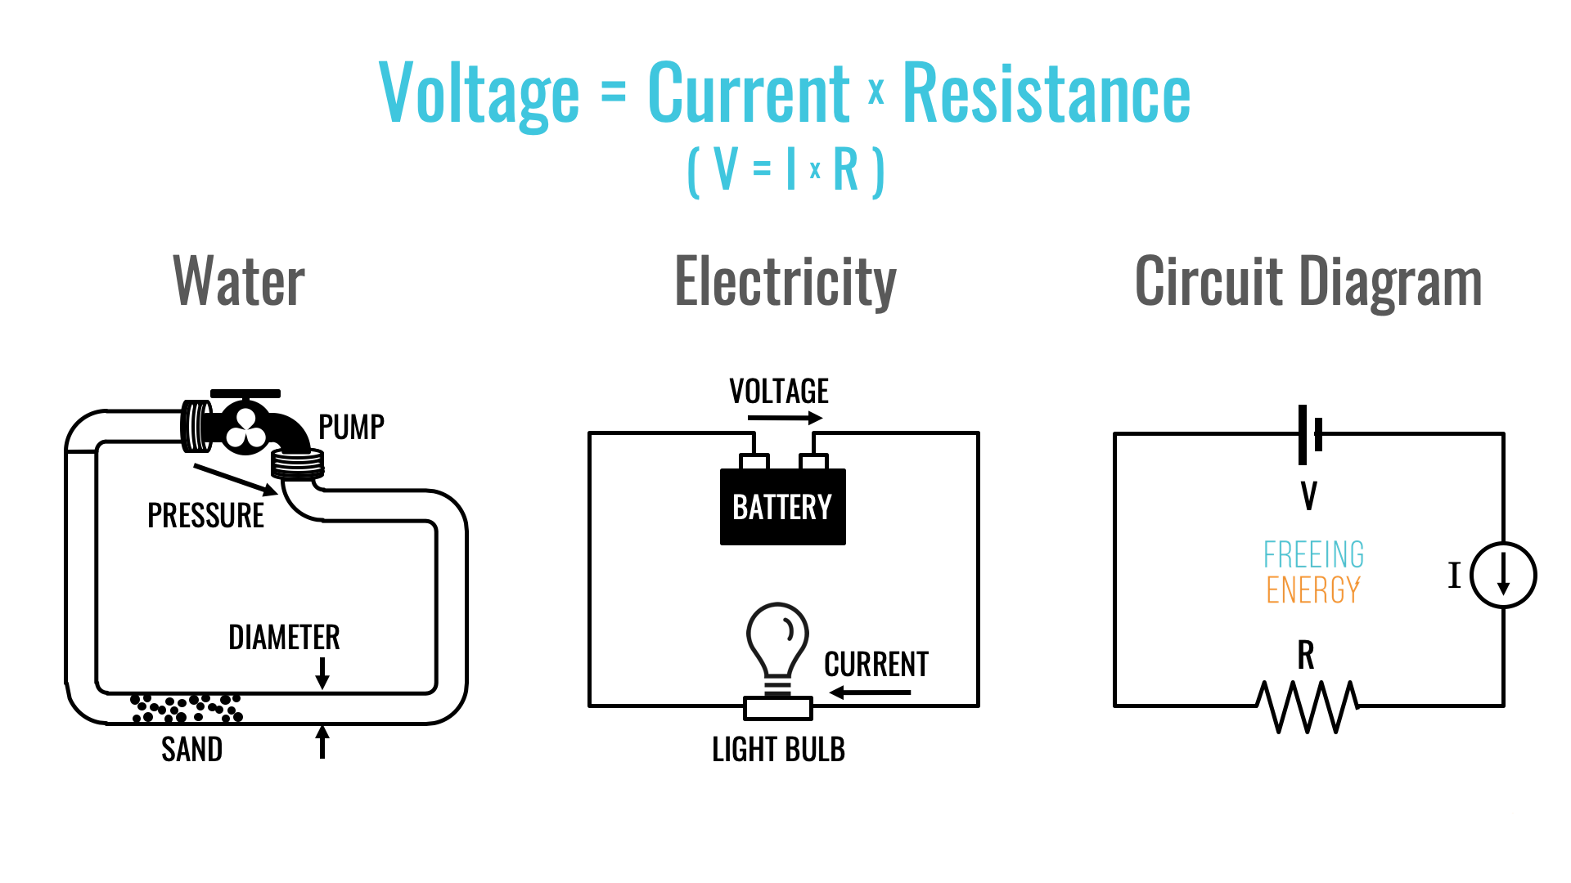
Schematics/diagrams
Notes:
An electronic circuit is circular. Batteries have a negative and a positive. For things to work there must be a loop positive to negative.

Slide 8
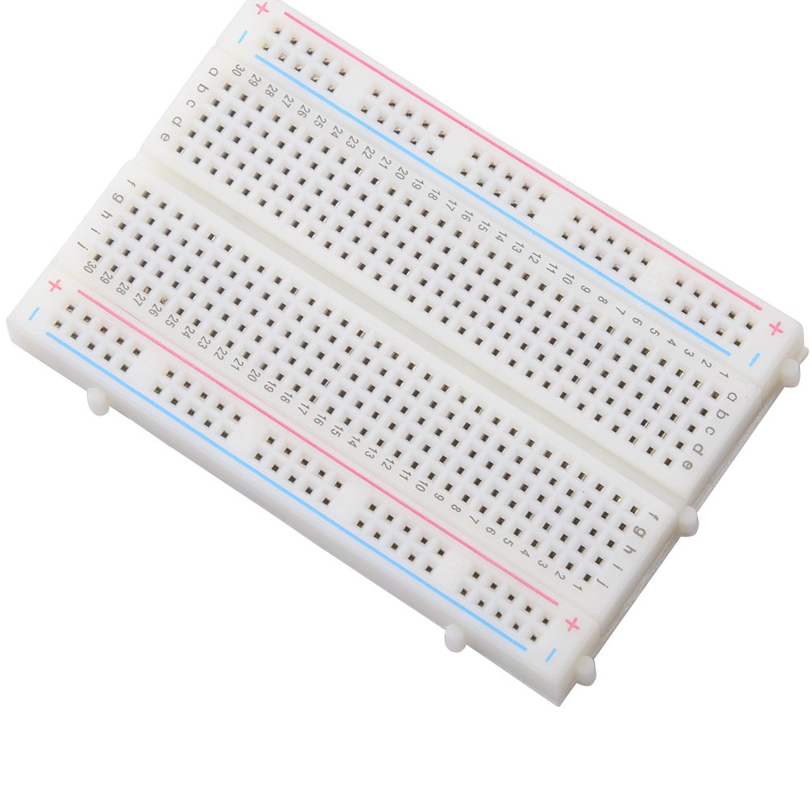
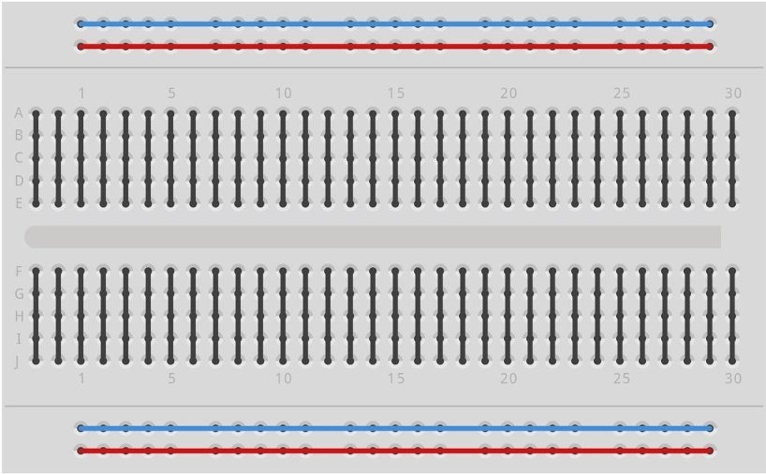
Breadboards
Allows for solderless prototyping
Come in various lengths
Most can be linked together to make more usable space
Handout: 1-to-1 breadboard protoboard
Alternatively examine the diagram on the right
Connected lines show what holes are connected
Supports most components
Gap in middle for Integrated Circuits (black boxes)

Slide 9
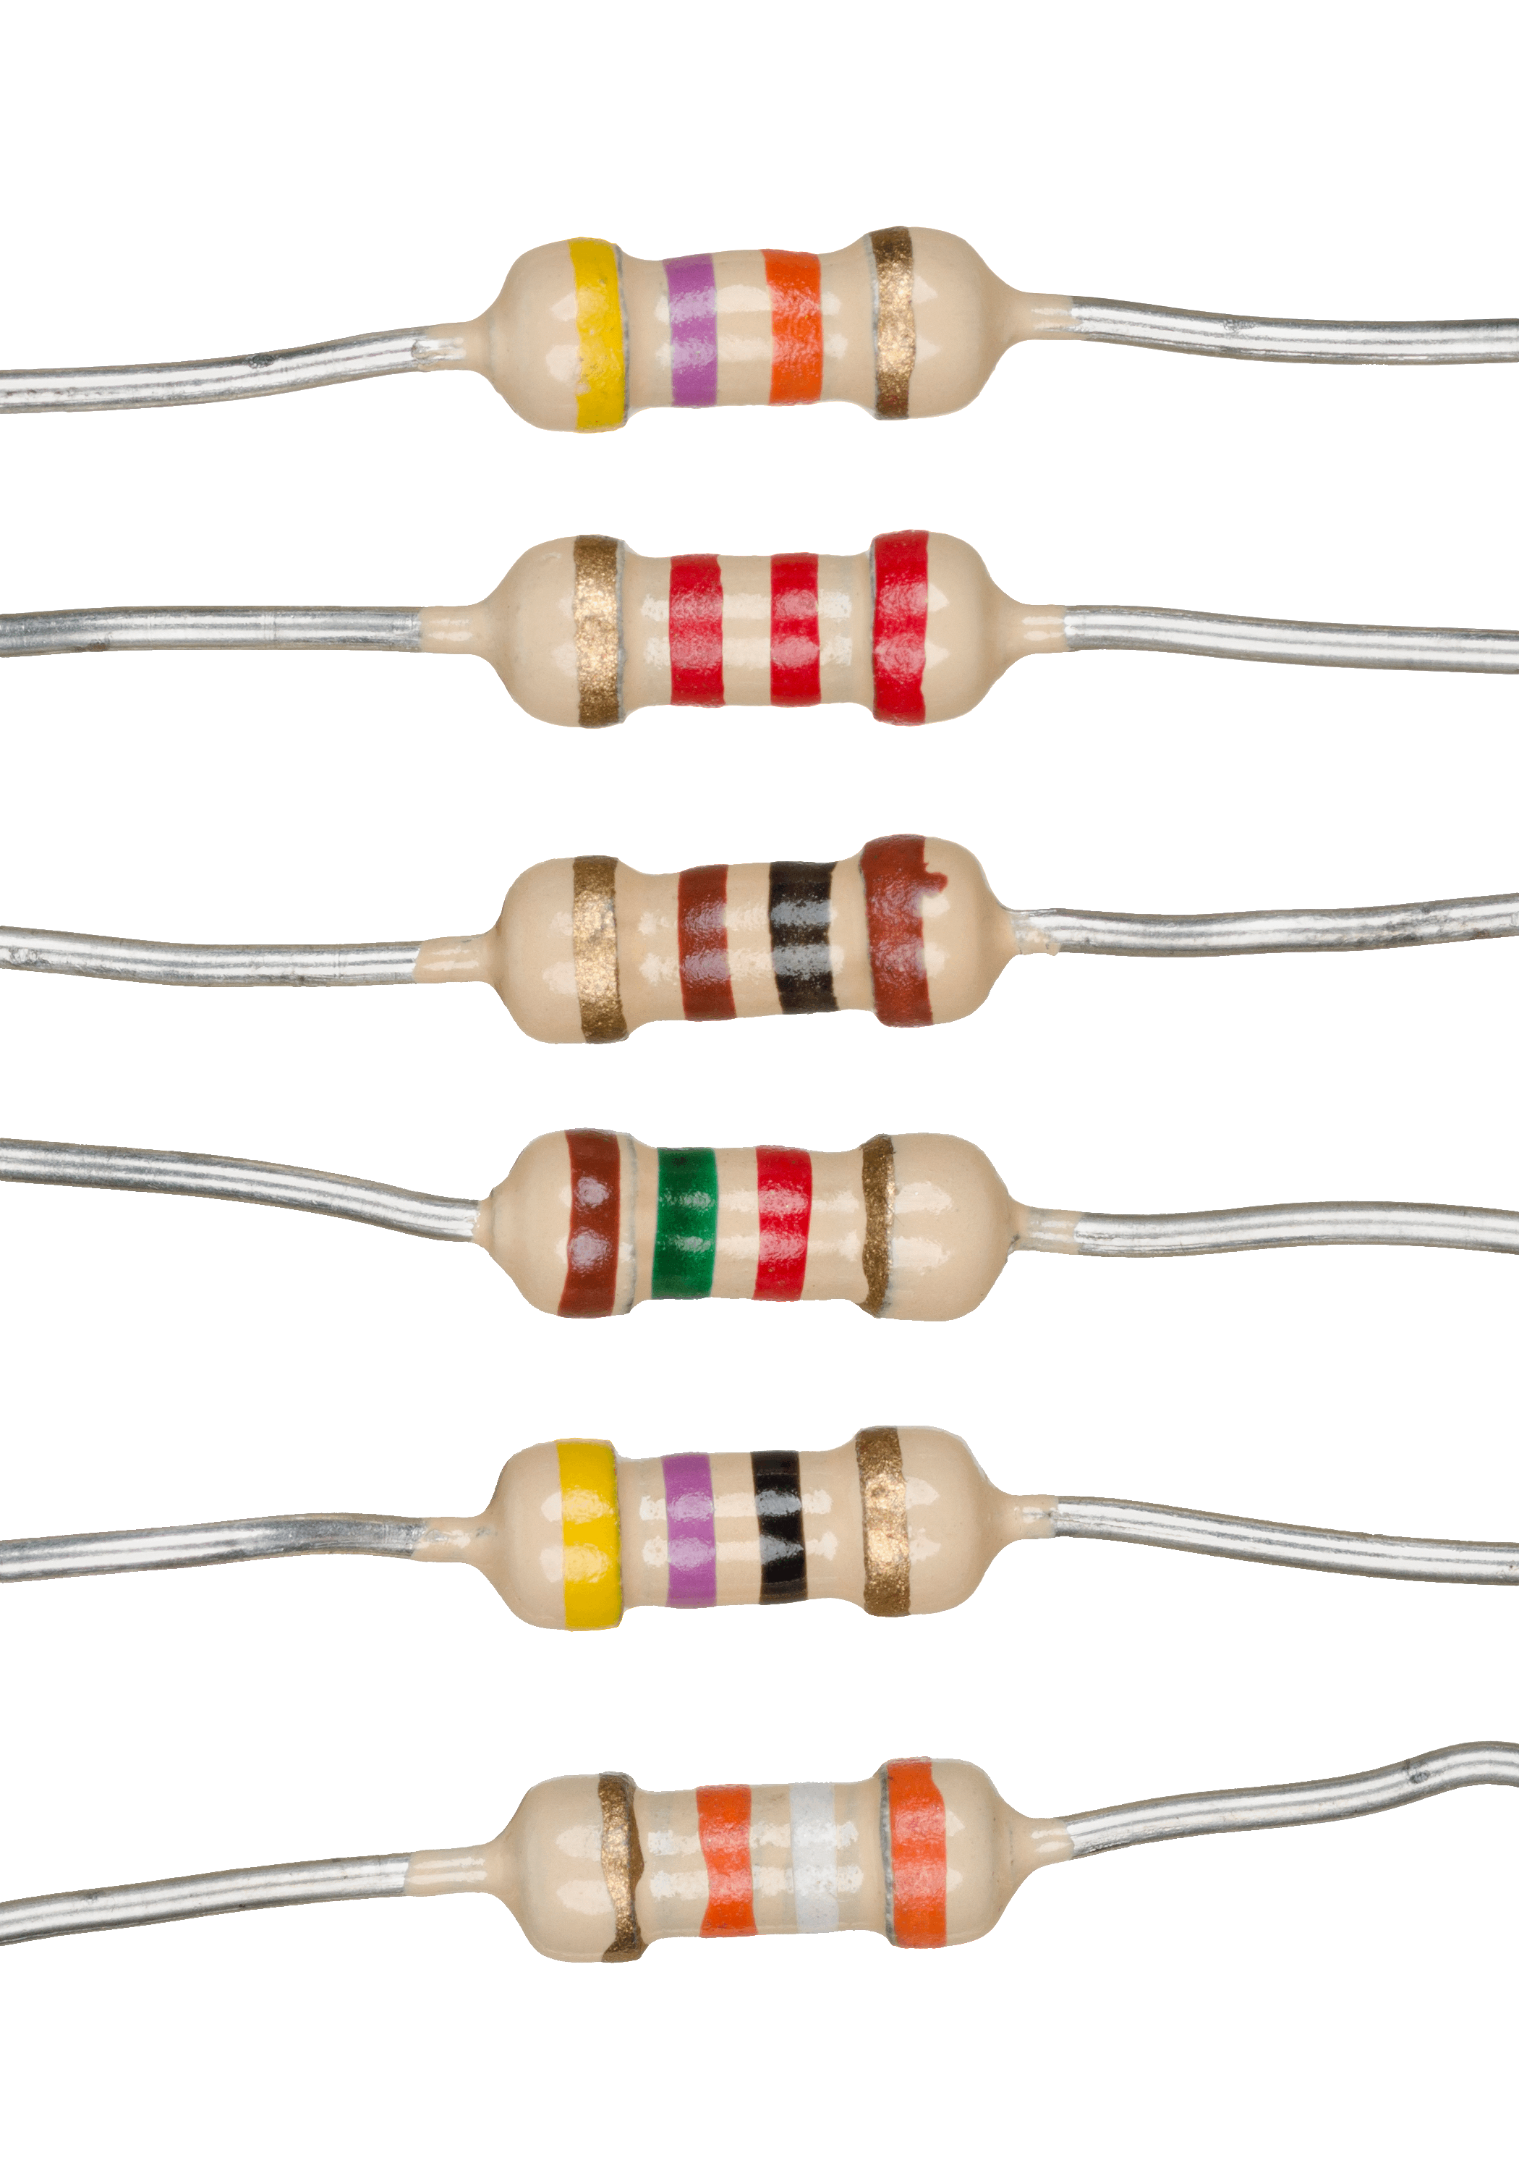
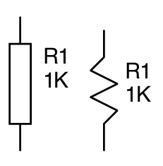
Resistors
Resist flow of current
Can be used to lower voltages
Can be used to lower current
Measured in Ohms
Color bands have meaning
Values aren’t logical (220? 470? Why not 200 or 500?)
Curiosity as a result of manufacturing
Tolerance ratings (1-20% of the target number)
Measuring with a multimeter
Notes:
To know the ohm value of a resistor you can look at the color bands or use a mutimeter. However, digital multimeters are simple to use and much quicker. Set a multimeter to the ohm (Ω) setting and hold one probe of the multimeter to one lead of the resistor, and the other lead to the other end of the resistor. Don’t let the metal from the two ends of the resistor cross or your reading will be 0. Look at the multimeter and it will show you what the value of the resistor is. It may be a little off—but it’s within tolerance!
The schematic symbol for a resistor is a rectangular box or a sharp tooth squiggly line

Slide 10
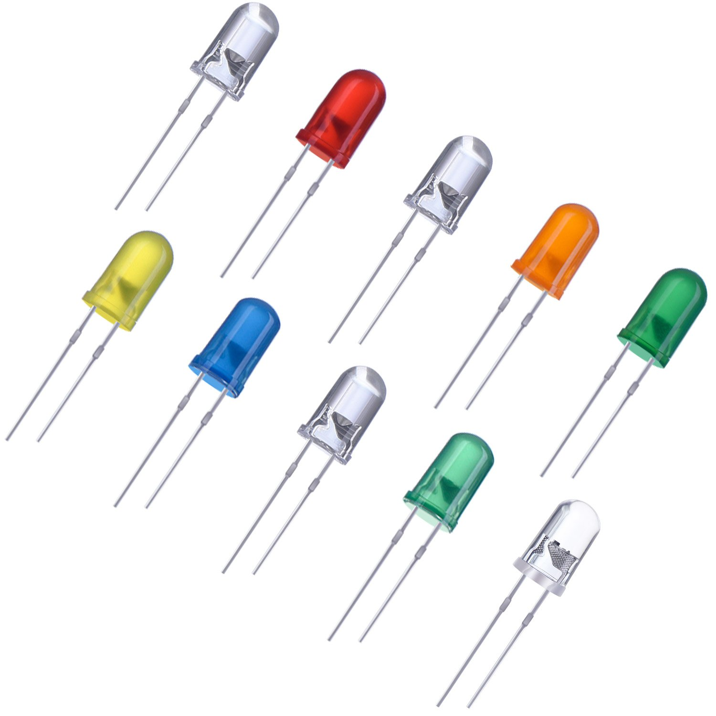
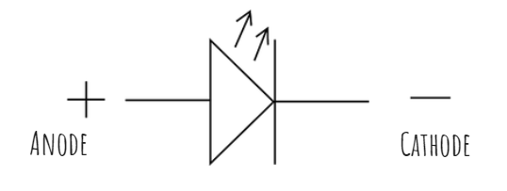
Light Emitting Diodes (LEDs)
Blinkenlights!
Have polarity/direction, long lead to positive
more [lead] to more [symbol]
Come in many different colors
Can also provide non-visible (UV) light
Can ‘burn out’ if too much current applied
This is why it’s paired with a resistor—to resist the flow of current
Notes:
The schematic symbol is a triangle pointing to a perpendicular line. Arrows point away from the triangle showing it emits light. The positive (longer lead) side is the side that looks like a greater than symbol. The negative side is the side with a line.

Slide 11
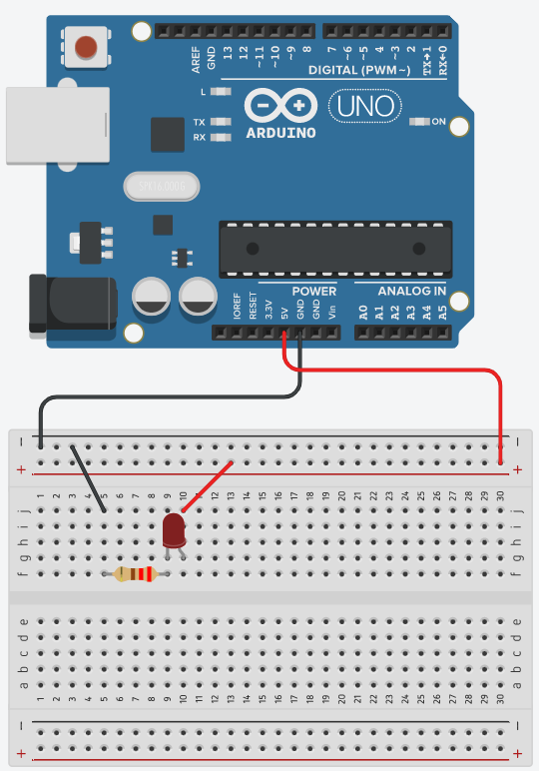
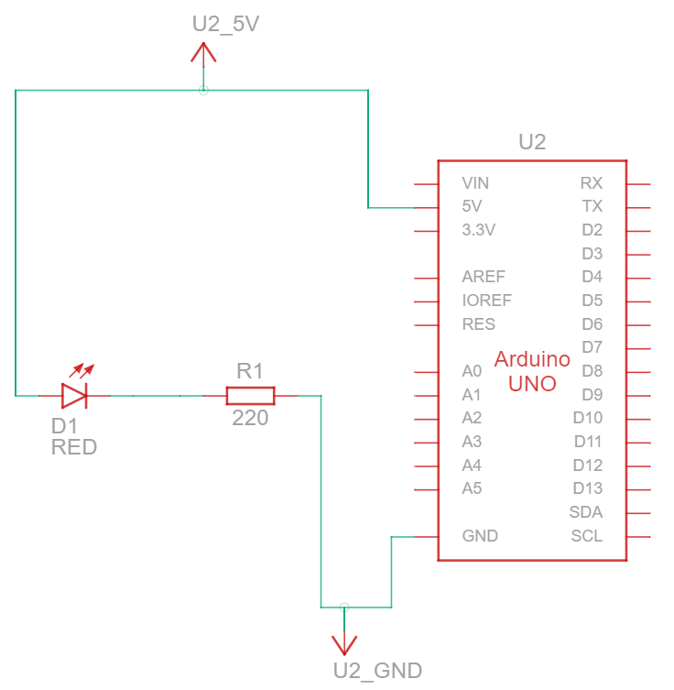
Serial.print('Hello, world!')
Notes:
On the left is a schematic. We will follow this schematic to create the physical version on the right. You can plug in the Ardunio (blue board) to USB now but it’s probably best to wait till the end.
Pull out the breadboard and wires from the kit. Connect ‘GND’ to the ‘-’ rail with a black wire. Connect the ‘5v’ output to the ‘+’ rail with a red wire. Find a 220ohm resistor (red, red, brown color bands) and gently but firmly fold the leads CLOSE TO THE RESISTOR to make a “U” shape. Be sure you have a 220 ohm and not a 220k ohm.
Plug one of the leads into hole F5 and the other into hole F9. It doesn’t matter which direction the resistor goes in. If you have trouble putting the leads in then use needlenose pliers to grab the leads and push then in near the board.
Next find an LED (red or otherwise) and notice that one lead is shorter than the other. Put the short lead into hole G9 and the long lead into G10. If you do this backwards then it won’t work, but it’s easily fixed with no permanent damage (this is why breadboards are great for experimenting—there’s no soldering!)
Connect J5 to the negative rail with a black wire and J10 to the positive rail with a red wire. Connect the Arduino to USB to provide power and…
The LED should light up! If it doesn’t then rotate the LED.
Notice how the schematic shows a loop from 5V (the source of positive voltage, also known as VCC) to GND/Ground. This shows that CIRcuits need to be CIRcles between positive and negative points!
https://www.tinkercad.com/things/kJNTD1qz4Sf-hello-world

Slide 12
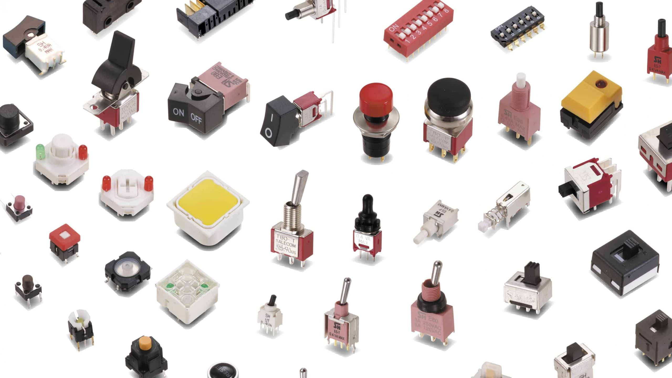
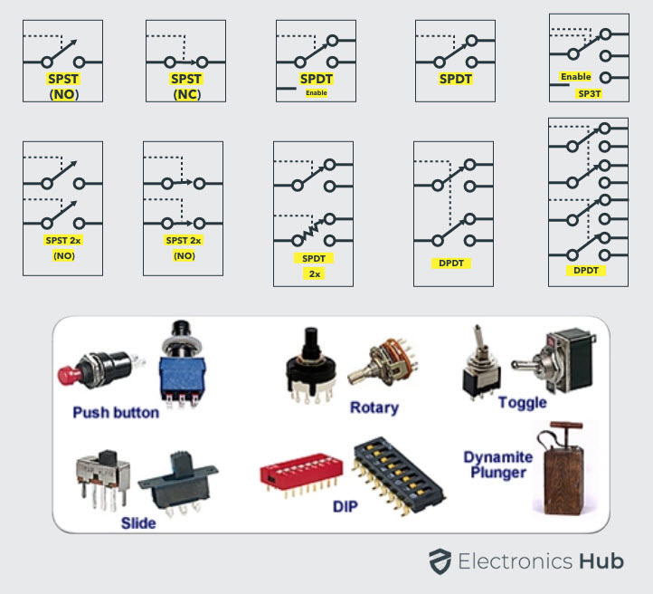
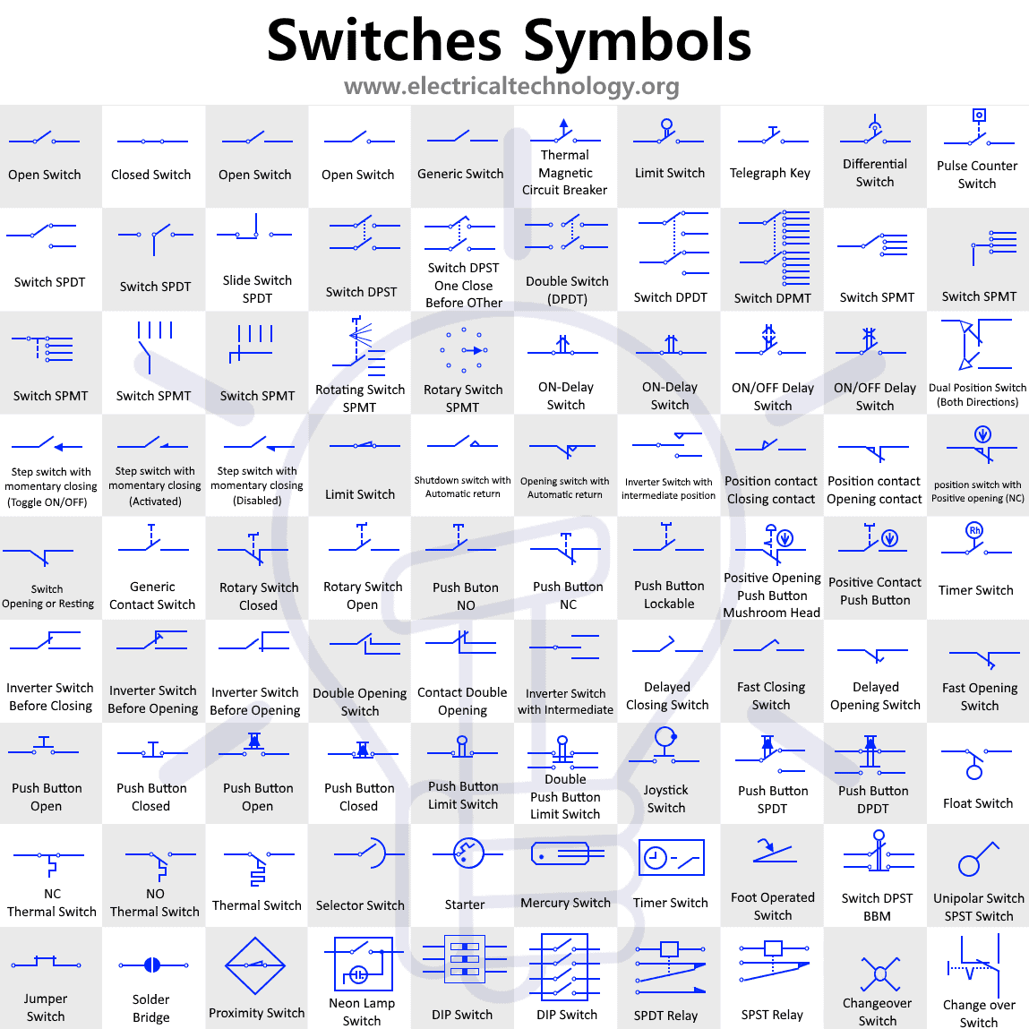
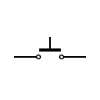
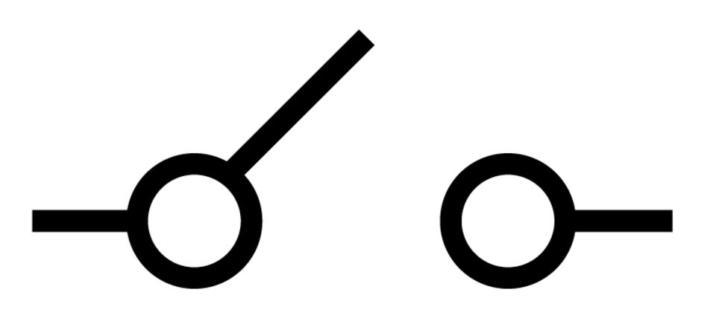
Buttons and switches galore!
How many ways can you make two pieces of metal touch?
Notes:
The human race is full of people with too much time on their hands. This can be shown with how many unique ways we’ve come up with to get two pieces of metal to touch. We also have a mind boggling amount of symbols to show this too! However the most common symbols are at the bottom of the middle of the slide. Most switch symbols are some variation on those two base symbols.
Switch types can be broken down to a few groups. One of these is a momentary push button, which is what you think of as a typical button. It’s ‘on’ when you push it and only while you push it. This is called single pull single throw.
Generally it’s best to look up what you need if you need more than a simple on/off switch/slider or momentary contact button.

Slide 13
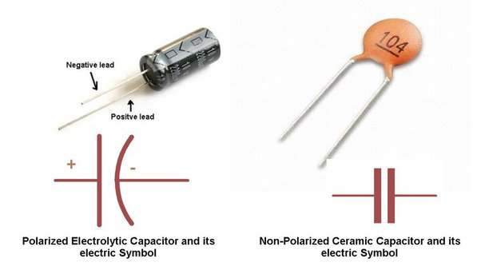
Capacitors
Short-term DC batteries
Two types
Electrolytic
Polarized
like LED, long lead = positive
strip (line) = negative (line)
Can dry out after decades
Small-large values
Ceramic
Non-polarized (like resistor)
Small values
Measured in farads
Electrolytic values easy to read
Search online for ceramic value (ex. ceramic 104)
WARNING: Electrolytics can “explode” if plugged in backward
Magic blue smoke (it makes things go)

Slide 14
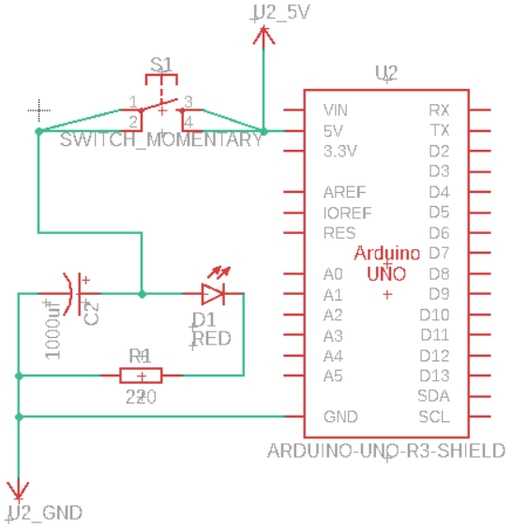
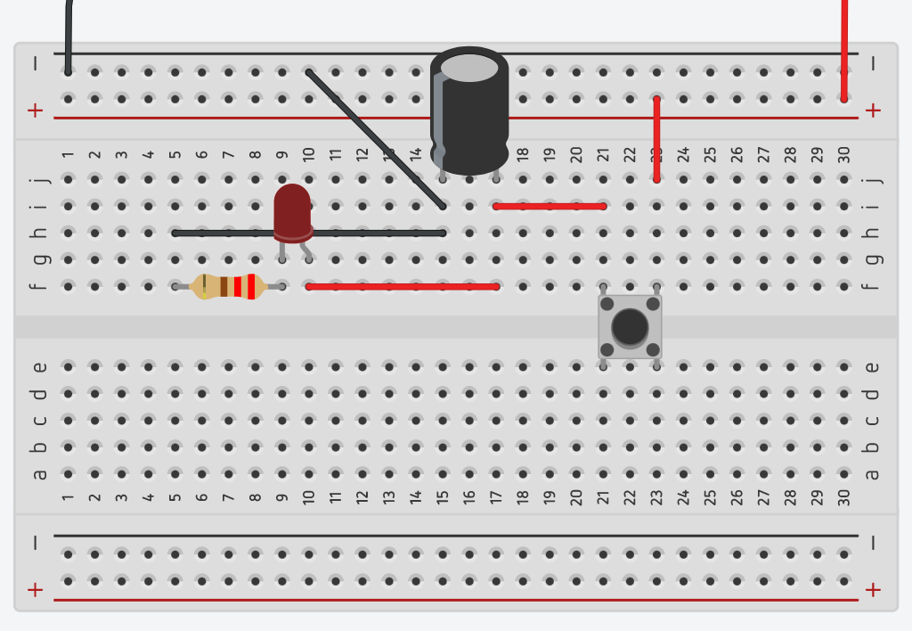
Fade out, part 1
Notes:
1. Disconnect power to Arduino
2. Add capacitor, switch, wires
3. Ensure capacitor stipe is negative
4. Power to Arduino, push button.
The LED should light up and slowly fade out. This shows that the capacitor is working as a small battery. It provides high voltage when fully charged and slowly decreases in voltage as it drains. Here’s what’s happening
1. Capacitor fills at button push
2. Capacitor drains on button release- providing less voltage and current as it drains
3. The LED glows bright then slowly dims
Notice that the clean loop that we had from the previous schematic still exists, but is a bit more complicated. It’s still a circle though!
https://www.tinkercad.com/things/4xenQ6Nk2gh-fade-out-pt-1

Slide 15
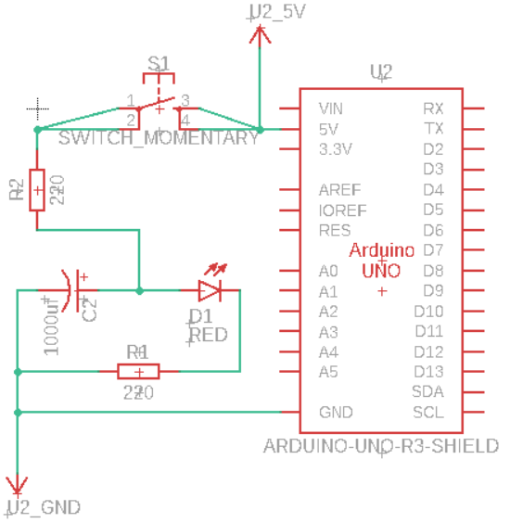
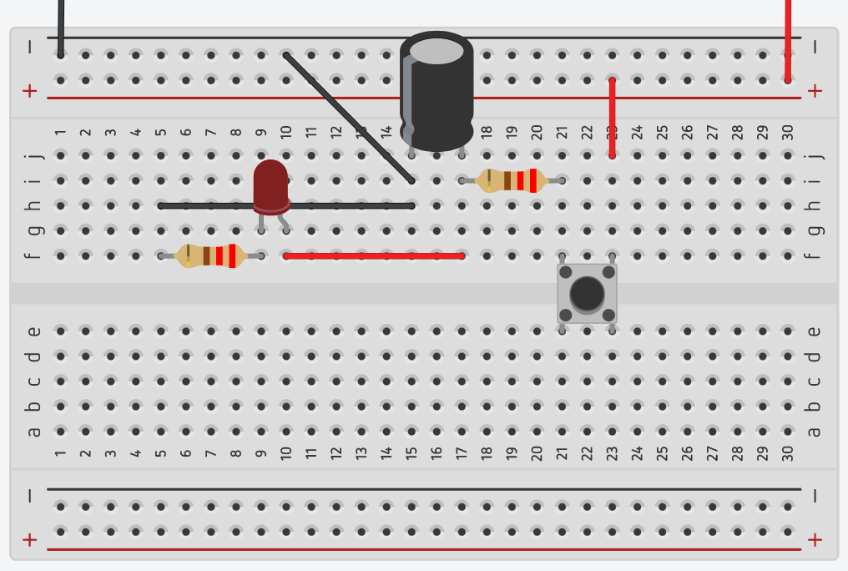
Fade out, part 2
Notes:
Replace wire i17-i21 with a 220ohm resistor
Notice that the LED charges up while holding the button. This is because previously there was no limit to the amount of current that could flow into the capacitor. Pushing the button would almost instantly fill the capacitor. Now that there is a resistor “upstream” it takes a while to fill up.
https://www.tinkercad.com/things/9Lg2XWiJTQL-fade-out-pt-2

Slide 16
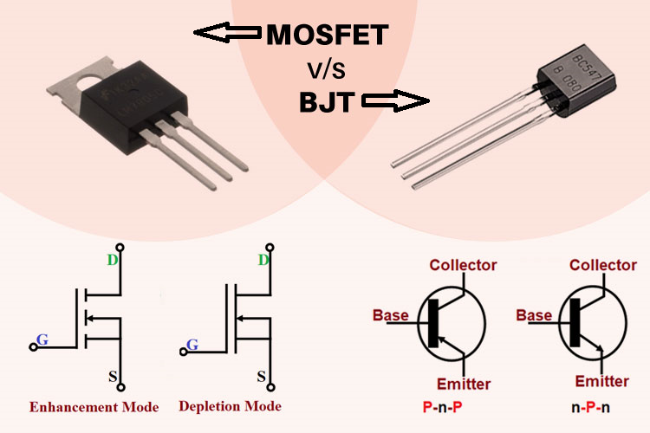
Transistors
Multiple uses
switch
amplifier
In, out, base (trigger)
NPN base needs + volts
PNP base needs – volts
Polarized
BJT
Common
Round
Power hog (relatively)
MOSFET
Static sensitive!
Square
Efficient
Notes:
If you’d like to know more about how transistors can be a switch or an amplifier see the first two videos on https://megaprocessor.com/stepping-stones.html

Slide 17
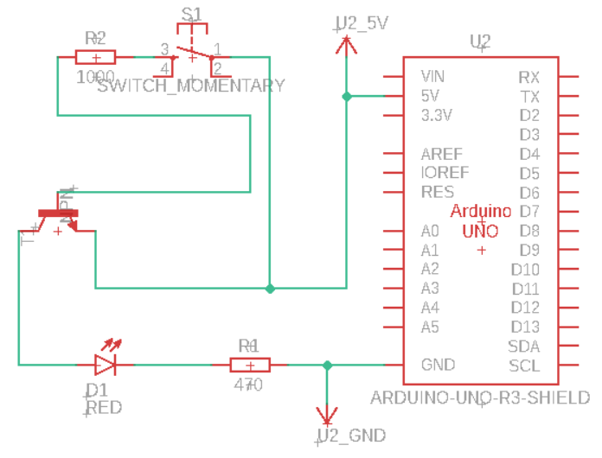
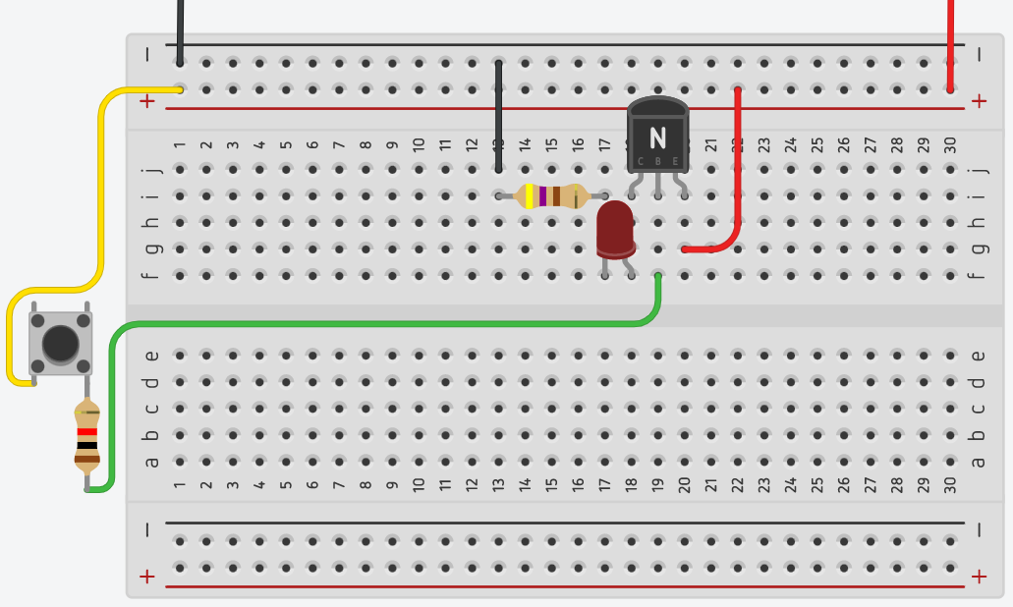
Put your finger on it
If desired, use finger instead of 1k resistor+switch
Caution: Electricity across heart, only use fingers from one hand
Notes:
Before we get into this circuit I want to highlight the caution on the slide. Electricity can be dangerous. At these voltages and amperage it’s extremely unlikely to be fatal, or even just hurt a little—but you should never get into the habit of letting electricity flow across your heart.
Only use one hand to connect the two wires.
We are going to build a circuit that demonstrates the how the resistor can be used as a switch. What better way to do get “hands on” experience with this than with your hand as part of the circuit!
Dry skin has a very high resistance. However it still allows a small current to pass through it. Thus we can use our finger to bridge the gap between the yellow and green wire, or R2 and S1 in the schematic.
Notice the addition of a second loop in the schematic. That’s the trigger loop for the transistor.

Slide 18
Pattern: Transistor as a switch
Low current controls independent current
Notes:
The circuit we just made can be thought of like a pattern in programming. In this case the pattern is using the transistor to control an independent current. For example say you wanted to control a larger voltage or current from a microcontroller (Arduino) this is how you’d do that for DC circuits.
We won’t be going into more detail here as this course is to get you familiar with basics and direct you to some things to learn on your own which can be done by searching for the title of this slide on your preferred search engine.

Slide 19
Extra bits and bobs
Relays
Photoresistor
Inductors
Diodes
Motors
voltage regulator
Logic gates
Notes:
Motors:
Collapsing magnetic field cause reverse voltage spikes, destroying components
Diodes only allow one-way voltage. Lookup “flyback diode”

Slide 20
Further learning: websites
Search online for the “pattern: *value*” text.
Tinkercad.com
falstad.com/circuit
megaprocessor.com/stepping-stones.html
nandgame.com

Slide 21
Further learning: books
Make: Electronics by Charles Platt
The Art of Electronics by Paul Horowitz and Winfield Hill

Slide 22
Further learning: YouTube channels
GreatScott!
Electroboom
BenEater
CircuitLabInc
Stefano91ste

Slide 23
FAQs
How did I generate the breadboard images? Tinkercad.com
How did I generate the schematics? Exported tinkercad.com to fushion 360 and manually laid it out
How do I know what IC’s are available? Like programming, immersion through copy/paste from StackOverflow.

Slide 24
Intro to electronics
Part 2
https://tinyurl.com/3xmw9jmh

Slide 25
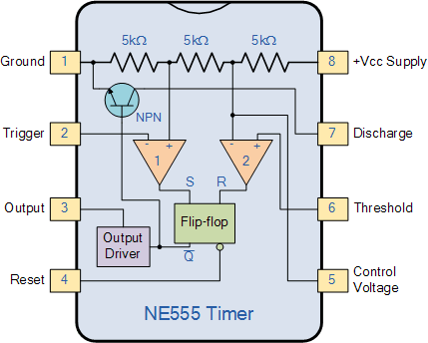
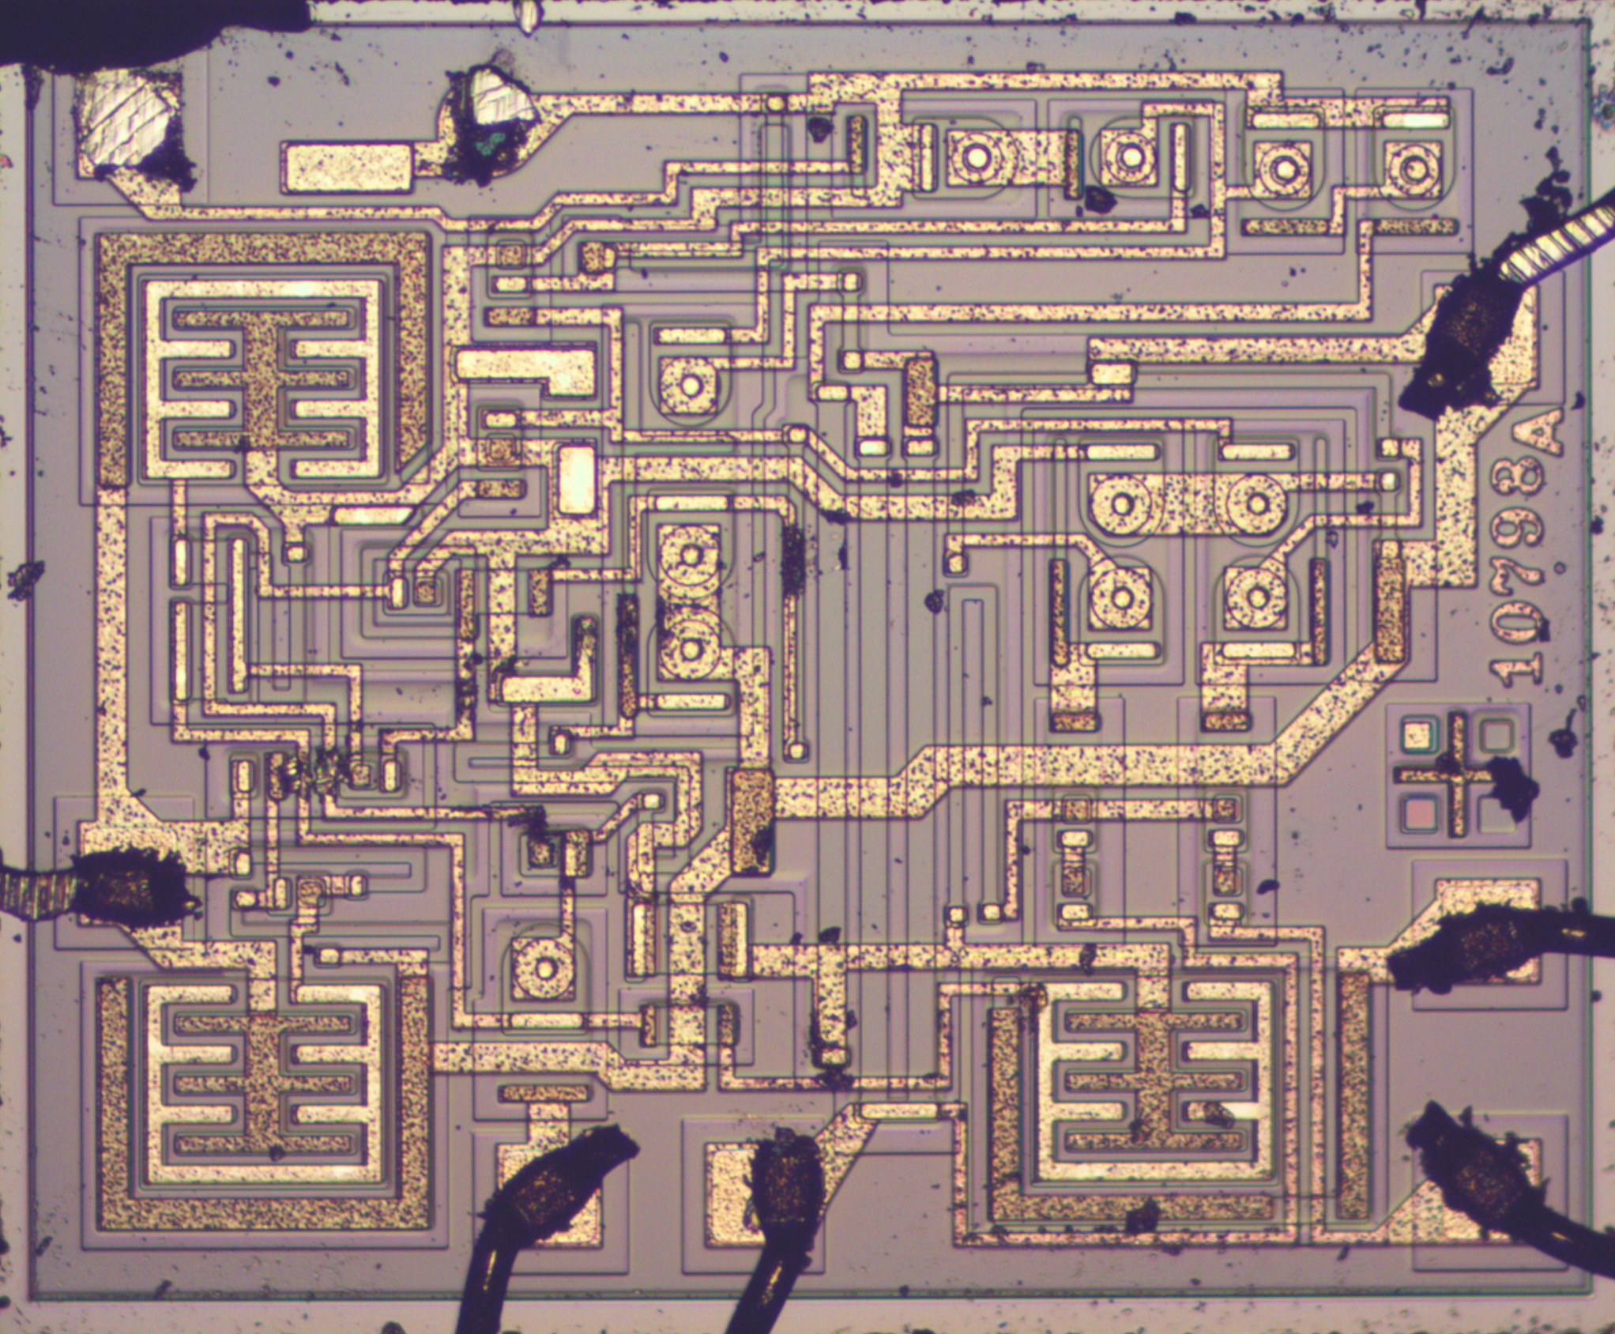
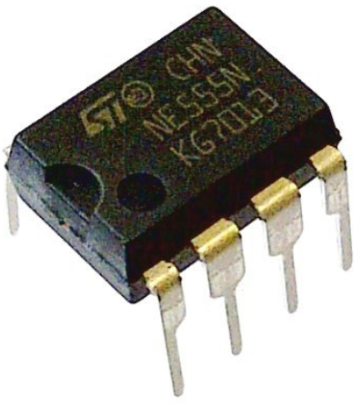
#include library: theory
Integrated circuits
Like importing a library
Pin 1 is dot, count up counter clockwise
Notes:
Circuits can get very complex. However much like in programming where you can import a library to save work, you can include an integrated circuit (IC) to save on complexity. An Integrated circuit is often a black rectangle with metal pins sticking out of it. See the left picture for an example.
The middle image is a block diagram that describes the inner workings of the integrated circuit, but don’t worry this isn’t how you are expected to figure out how to use an IC. For that you use a datasheet. We’ll get back to datasheets later.
The image on the right shows the inner workings of the chip. Even without going into which bits of metal make what components you can get an idea of how complex this circuit really is. You can see that fitting all that into 8 pins saves quite a bit of space.
Pin 1 on Ics have a dot. Count up counter clockwise to find a specific pin.

Slide 26
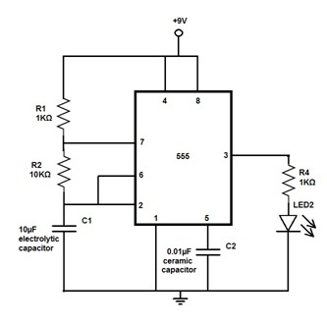
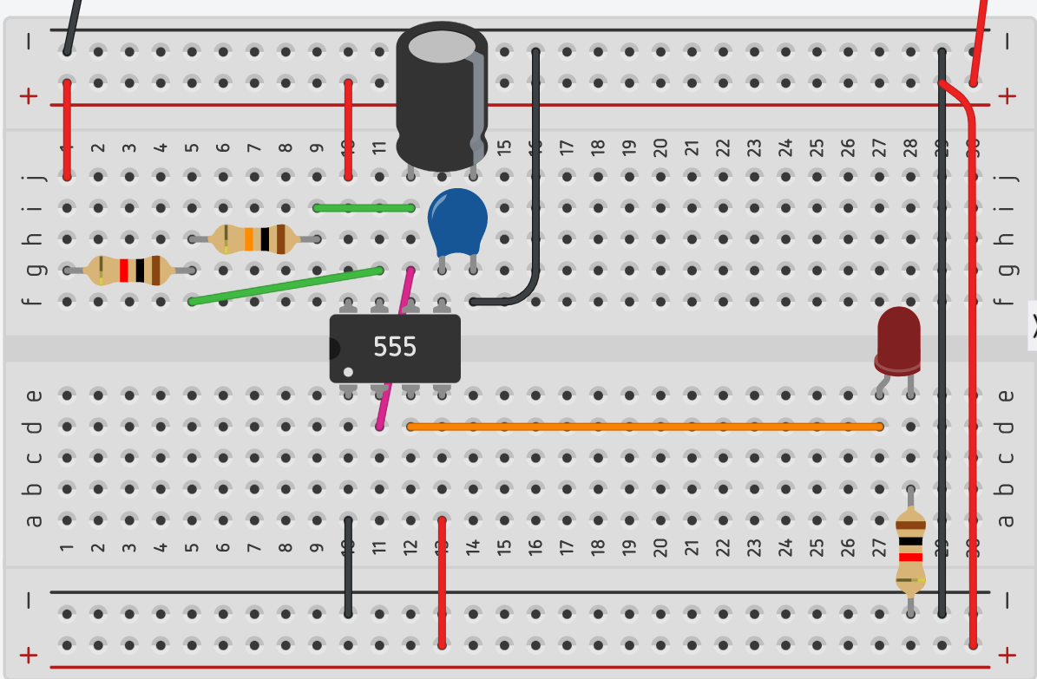
#include library: project
Notes:
1. Put the 555 timer with pin 1 on E10 such that the IC crosses the gap in the middle of the breadboard with every pin in a hole.
2. Connect the two power rails so that they act as a single power rail (positive to positive, negative to negative)
3. Tie pin 1 to ground
4. Tie pins 4 and 8 to positive
5. Put a 1k resistor between G1 and G5.
6. Put a 10k resistor between H5 and H9.
7. Tie J1 to positive.
8. Tie pin 7 to F5.
9. Tie I12 to I9.
10. Tie pin 6 to pin 2.
11. Put a 10uF electrolytic capacitor between J12 and J14. Remember electrolytics are polarized to be sure the negative strip is in J14.
12. Put a ceramic 0.01uF (number code 103 on the coating) capacitor between G13 and G13.
13. Tie F14 to ground.
14. After all that is done we can link pin 3 to our output. In this case a simple LED circuit as seen on the right. Use a 220 ohm resistor.

Slide 27
#include library: retrospect
555 IC has three operating modes
Astable (not stable—this is what we made)
Monostable
Bistable
Documentation/datasheet
How to change times?
Understand voltage divider and capacitor math.
This project used a voltage divider pattern
Notes:
The 555 timer has multiple operating modes. One of these is astable, which we just used. This type of circuit is also called an “astable multivibrator”.
The other two types are monostable and bistable.
In monostable you can use an external trigger to send an output for X amount of time.
In bistable you can set the output to be either on or off with a voltage pulse. This differs from a switch which has to maintain the desired voltage.
As for understanding how the 555 works and how to use it, along with other ICs you can lookup the “${IC number} datasheet”. There’s often a section on that describes common use cases for that IC.
But what about changing how long or often the LED lights up? That is a result of the voltage divider pattern between the trigger and threshold pins or the capacitor/resistor
This project used a voltage divider pattern which we will discuss more in next slide.
https://www.555-timer-circuits.com/operating-modes.html

Slide 28
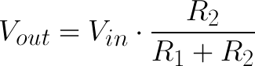
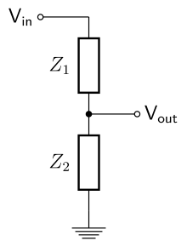
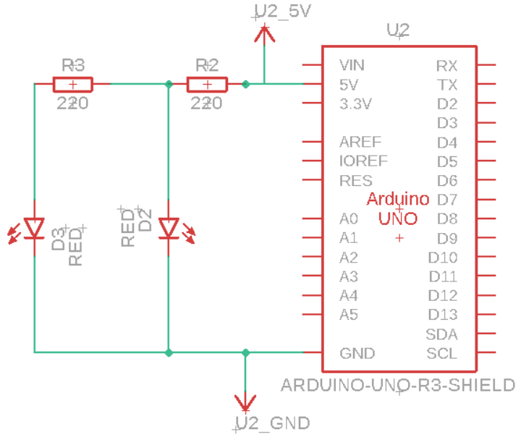
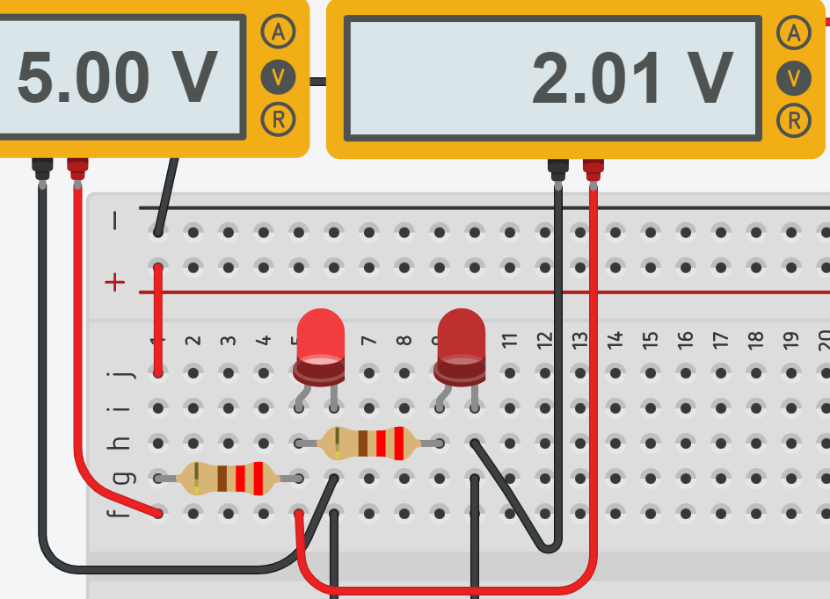
Pattern: voltage divider
Notes:
A voltage divider is two resistors in series (one after the other) that can be used to generate a lower voltage in the middle than what is fed in at input. The resulting voltage between the resistors depends on the value of both resistors.
We won’t be going into more detail here as this course is to get you familiar with basics and direct you to some things to learn on your own which can be done by searching for the title of this slide on your preferred search engine.

Slide 29
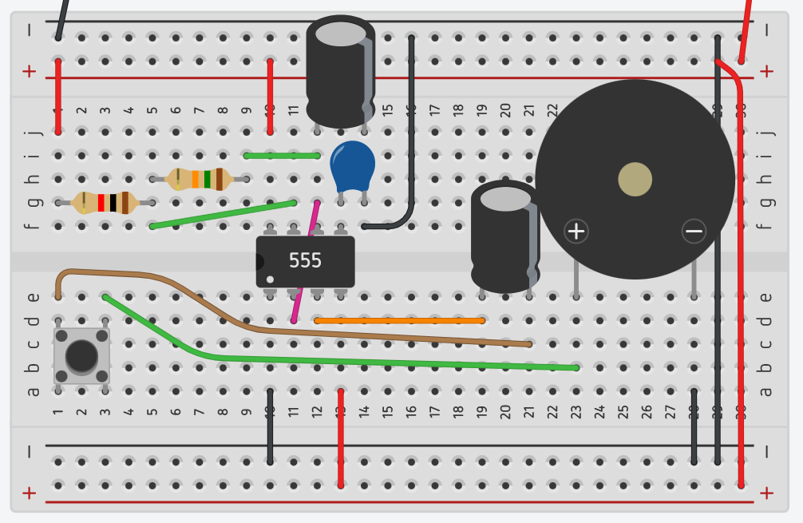
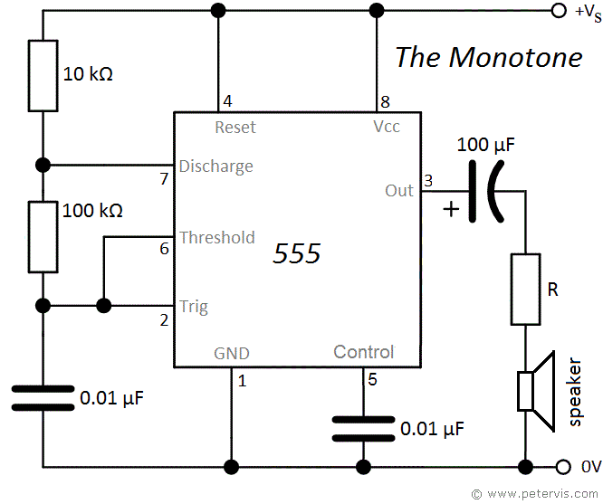
Come on make some noise!
Replace top capacitor with 0.01uf
You want to include the button
Different diagram,
Still astable
Only output (pin 3) changed
Notes:
Remove the output circuit that is the LED and resistor on the bottom right.
Replace the top electrolytic capacitor with 0.01uF
Put a 1 nF capacitor
Put a button between the

Slide 30
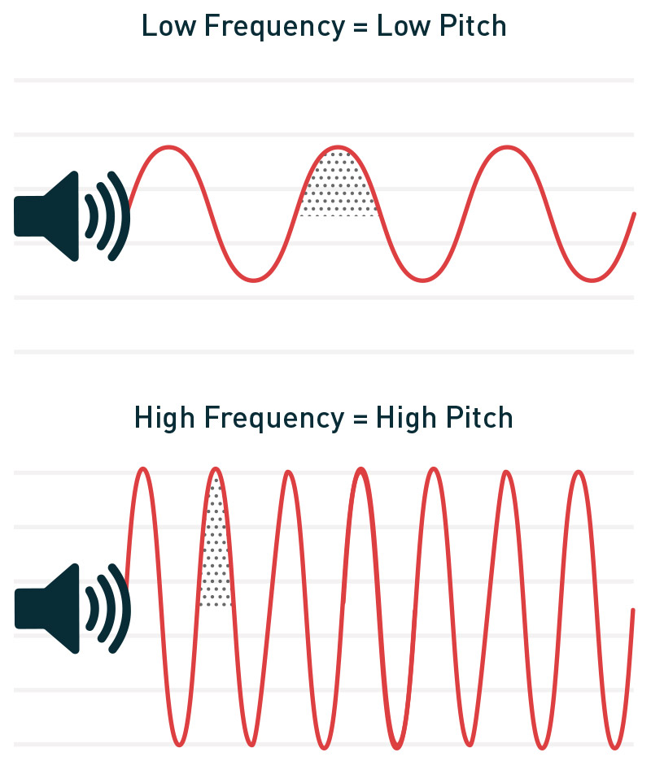
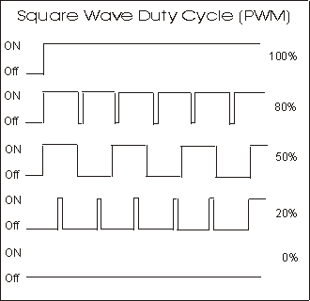
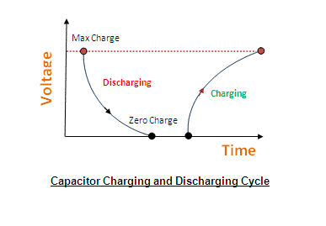
A little bit of physics never hurt anyone
Notes:
So we made some noise. How?
The 555 timer produces a high or low voltage on it’s output. Depending on how quickly this happens you’ll have more time with power “on” than “off”. However you can’t feed this directly to a speaker. Sound isn’t square. Sound is wavey. If we remember from our earlier circuit using resistors, buttons, and capacitors, we can recall that the LED would brighten or dim depending on how long we pressed the button. That button was charging the capacitor which turned the “on or off” pulse into smoother voltage curves.
If you do that quickly enough you can get into the range of human hearing. Pipe that into a speaker and you get sound!

Slide 31
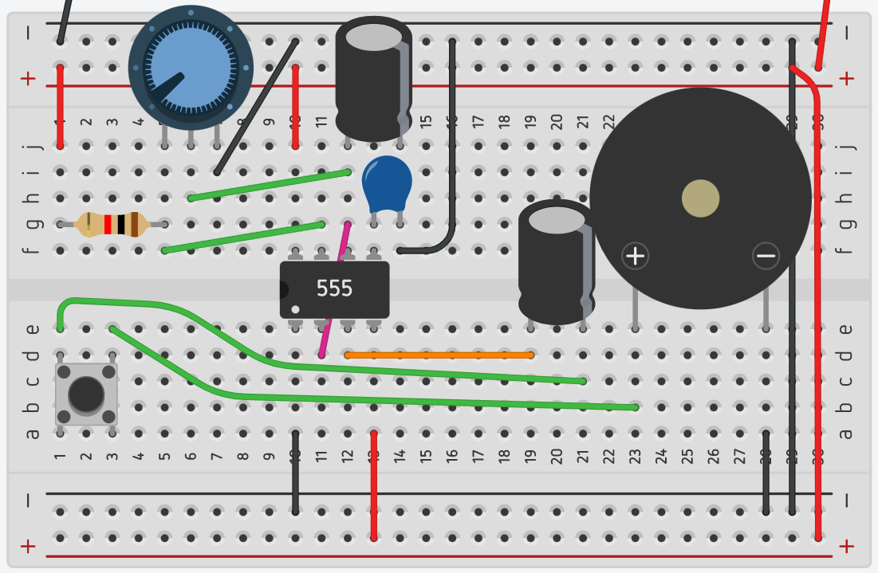
Exercise for better tone
Notes:
Remove the 2nd resistor at the top of the breadboard.
Put the trimpot on the board with leftmost pin on the 1st resitor’s output.
Move the connection that was going from the electrolytic capacitor to the resistor to the middle pin on the trimpot.
Connect the rightmost pin of the trimpot to ground.
Why do you think we connected the output to the middle pin? What pattern did we recently view that had 3 legs and 2 resistors?
When ready push the button for tone

Slide 32
Arduino
Microcontroller that can interact with hardware directly
C++ although you can use MicroPython
Great for logic but not directly driving power
40mA max output per pin (200 total), see transistor switch pattern
Prebuilt “Arduino shields” extend functionality
Popularity means adding sensors is easy

Slide 33
Setting up Arduino
Install Arduino IDE (arduino.cc/en/software)
Connect Arduino
Open “Arduino IDE”
“Tools” > “Board” > “Arduino AVR Boards” > “Arduino Uno”
“Tools” > *select port*
Code
Press upload (right arrow button)

Slide 34
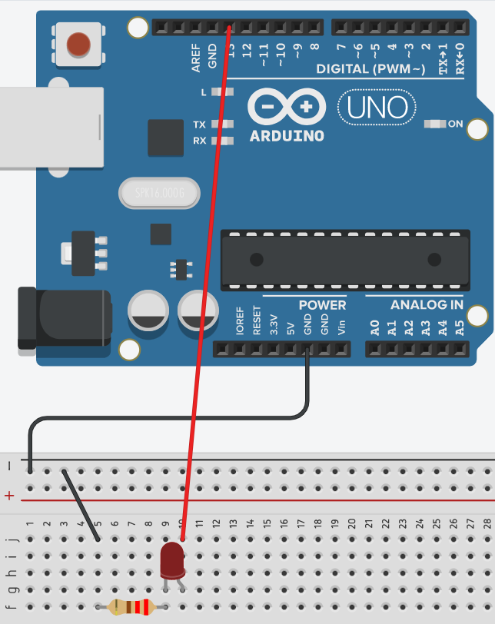
Blink, hardware
Simple LED circuit
220 ohms
Positive from LED to pin 13

Slide 35
Blink, software
Arduino IDE
File > Examples > Basics > Blink
Upload (right arrow)

Slide 36
Fade
Move from Arduino pin 13 to pin 9
File > Examples > Basics > Fade
Upload (right arrow)
Notice ~ next to pin. That’s PWM/Duty cycle (see make some noise)

Slide 37
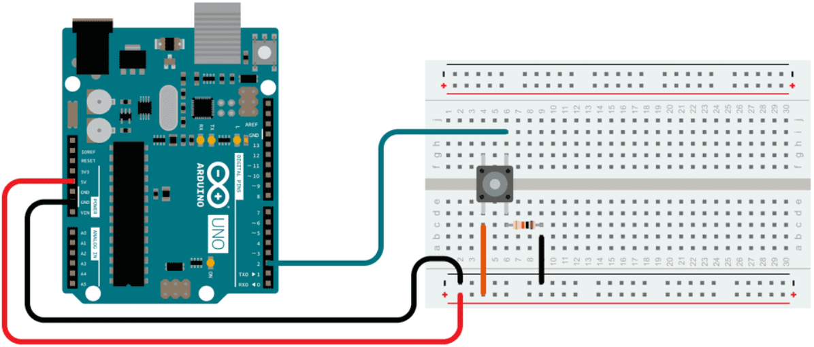
Getting input, hardware
Use a 10k ohm resistor

Slide 38
Getting input, software
Put a button on the breadboard.
Positive to pin 2
Negative to GND
File > Examples > Basics > DigitalReadSerial
Upload (right arrow)
Tools > Serial Monitor

Slide 39
Extra projects/tasks
Turn “Come on make some noise” into multiple notes (piano)
Change the resistors or capacitors in the 555 circuit. Maybe add resistors between the capacitors and ground (both or individually)
Turn 555 into a monostable configuration (button lights LED for a bit)
Try creating an “astable multivibrator” without the 555
What are
Pull-up/pull-down resistors
decoupling capacitors
SPST vs DPDT switches
Resistor or capacitor in serial or parallel

